Slide 1

Quorum Architecture
1

Slide 2













Quorum Architecture
QUORUM NODES
CONSTELLATION
STATES
PUBLIC STATES
PRIVATE STATES
CRYPTO ENCLAVE
HTTPS
TRANSACTION MANAGER
TRANSACTIONS
SMART CONTRACTS
CONSENSUS
NETWORK MANAGER
GO-ETHEREUM

Slide 3
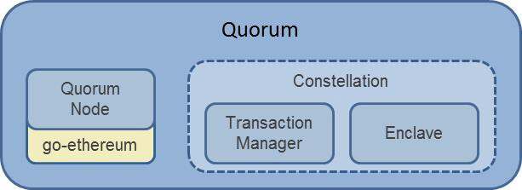
Quorum Architecture
Following components make up the Quorum Architecture:
Constellation:
Crypto Enclave: It is responsible for encryption and decryption of private transaction data and
private key management.
Transaction Manager: Allows access to encrypted data for private transactions and manages
Local data store.
States: State is an immutable object that represents facts which are known by one or more nodes at
a specific point of time. Quorum states are divided into two:
Private States
Public States
Transactions: Transactions are the proposals used to update the ledger.
Network Manager: Controls the access to network and enables a permissioned network creation.

Slide 4
THANK YOU!

